Slide 1



fullstackdatascience.com
Lesson 10 - Dax (Advanced) and Context
Power BI
Created by Huydata
DA K6
Lesson 3
huynt@fullstackdatascience.com
1

Slide 2

Learn
About
01/
Filter Context - Row Context
02/
DAX (Advanced)
03/
Lab
fullstackdatascience.com
2

Slide 3

Filter Context
And
Row Context
Row Context and Filter Context are two core concepts essential for understanding how DAX calculates values
3

Slide 4
Row Context
Row context occurs when a DAX formula is applied to each row of a table. It’s like "looping through each row," with the calculation based on the current row's values.
When it occurs:
When using calculated columns
When using functions like SUMX, FILTER, ADDCOLUMNS – which iterate through rows
Product | Quantity | Price
A | 2 | 100
B | 3 | 200
Product | Quantity | Price | Total
A | 2 | 100 | 200
B | 3 | 200 | 600
Total = Sales[Quantity] * Sales[Price]
DAX evaluates each row.
Row 1: 2 * 100 = 200 | Row 2: 3 * 200 = 600
=> This is row context, because DAX knows which row it's working on.
5

Slide 5
Filter Context
Filter context happens when a calculation is performed within a filtered environment, such as a slicer, chart filter, or using CALCULATE.
When it occurs:
In measures
When using CALCULATE, FILTER, ALL, ALLEXCEPT to modify filters
Product | Quantity | Price
A | 2 | 100
B | 3 | 200
Product | Quantity | Price
A | 2 | 100
B | 3 | 200
Total Revenue = SUM(Sales[Quantity] * Sales[Price])
This measure automatically reacts to the filter context
Try creating a card and a slicer to test the change!
5

Slide 6
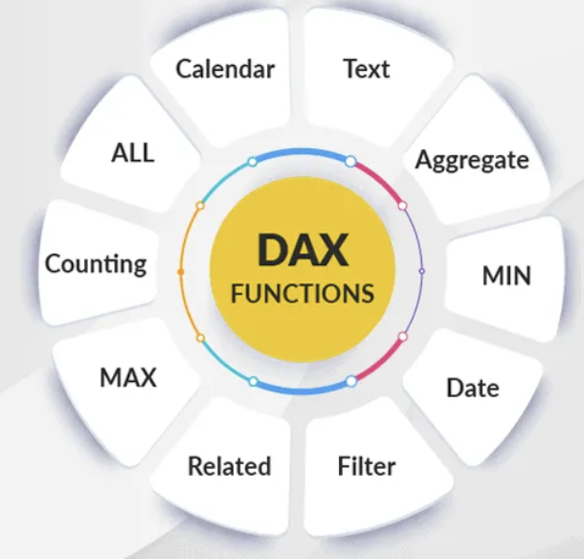
DAX (Advanced)
DAX stands for Data Analysis Expressions.
3

Slide 7
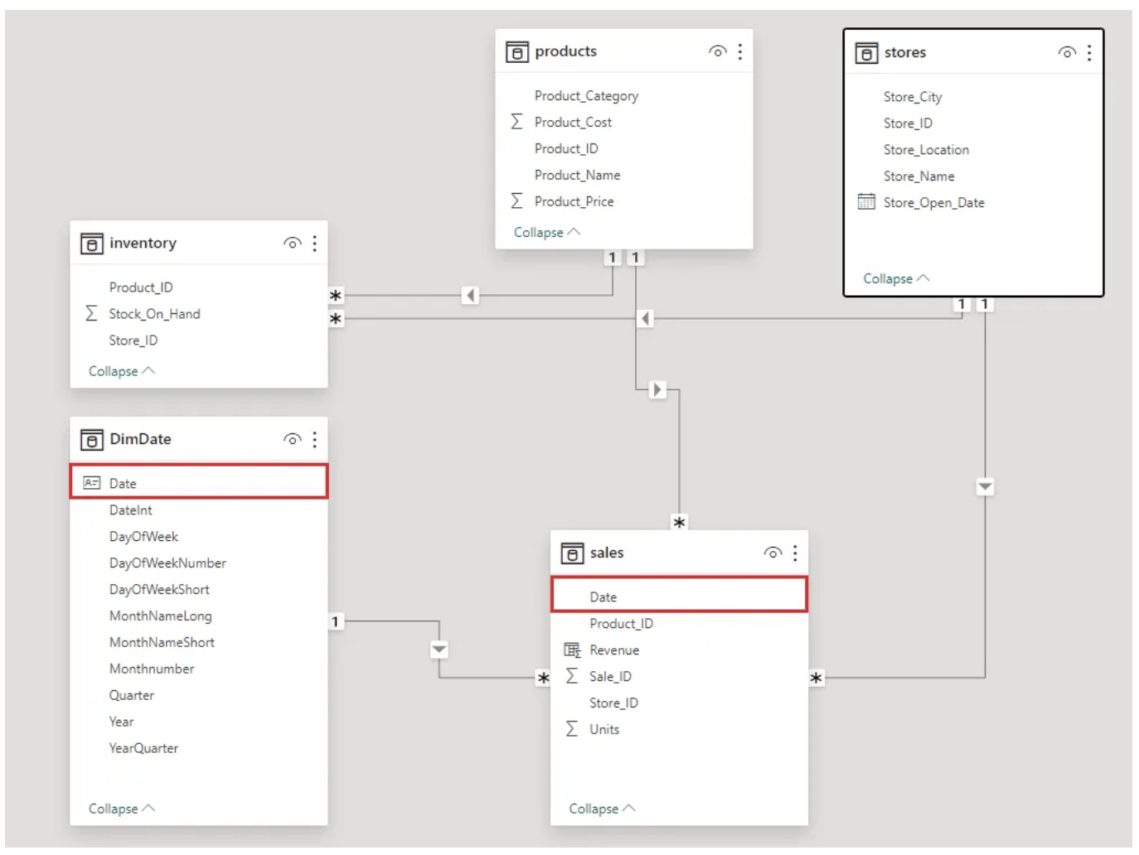
DAX 1 - Dimdate
5

Slide 8
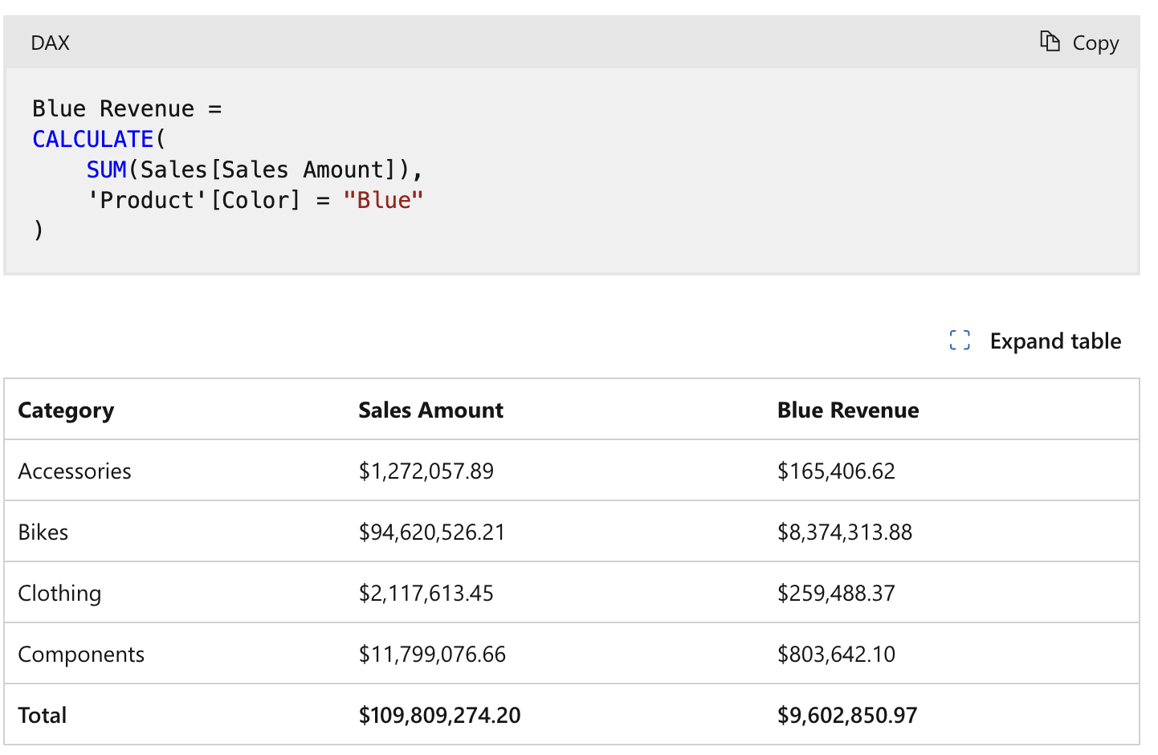
DAX 2 - Calculate
Evaluates an expression in a modified filter context.
5

Slide 9
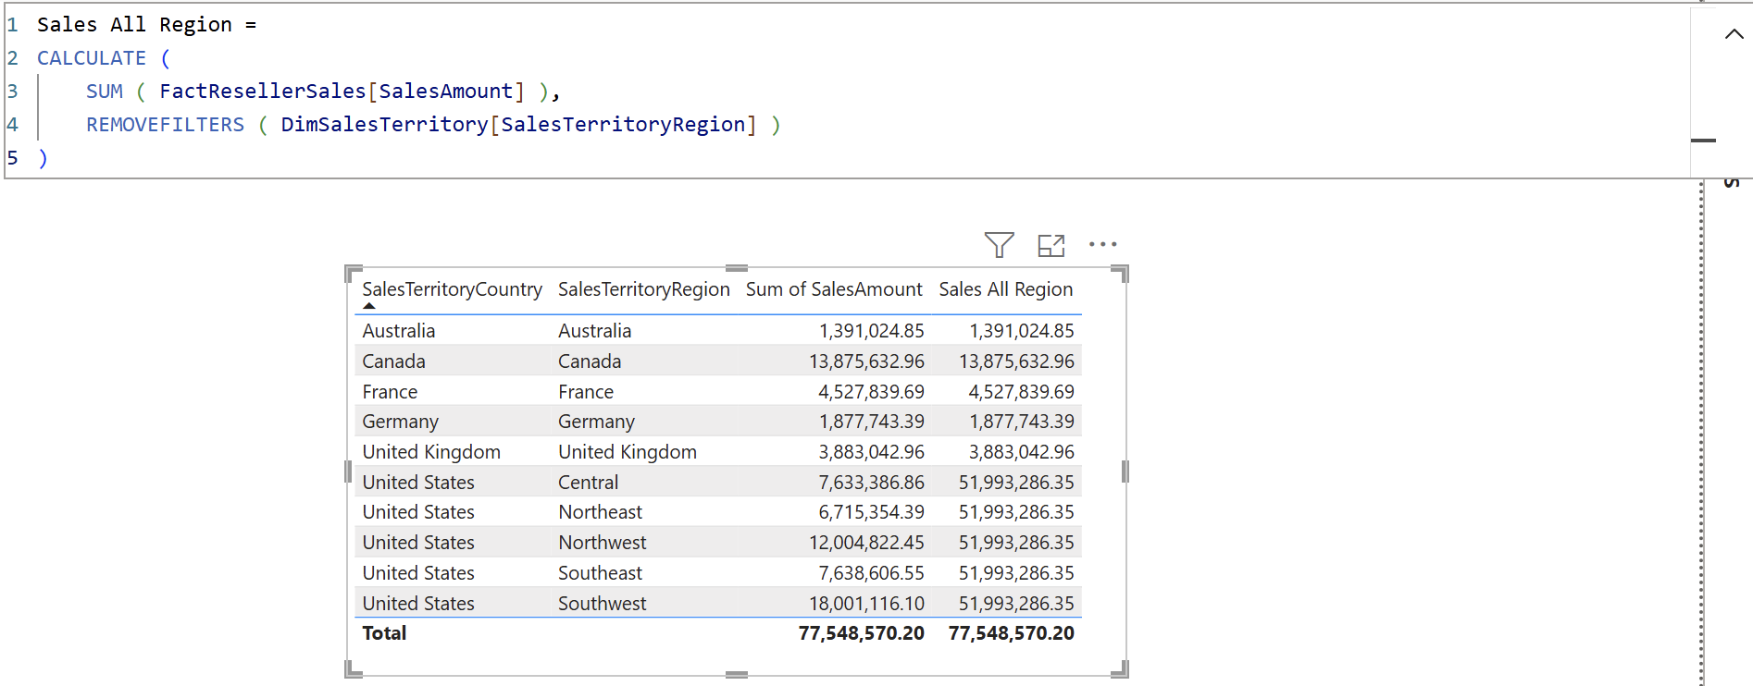
DAX 2 - Calculate (Filter context)
Evaluates an expression in a modified filter context.
5

Slide 10
DAX 3 - Time Intelligence
Create a column to calculate cumulative in Table Chart
Revenue YTD = TOTALYTD([Total Profit], DimDate[Date], "07-14")
Revenue DatesYTD = CALCULATE([Total Profit], DATESYTD(DimDate[Date], "07-14"))
Create a column to Compare revenue between 2 time periods
Profit Prior Year = CALCULATE([Total Profit], SAMEPERIODLASTYEAR(DimDate[Date]))
Profit YoY% = [Profit Prior Year] / [Total Profit]
5

Slide 11
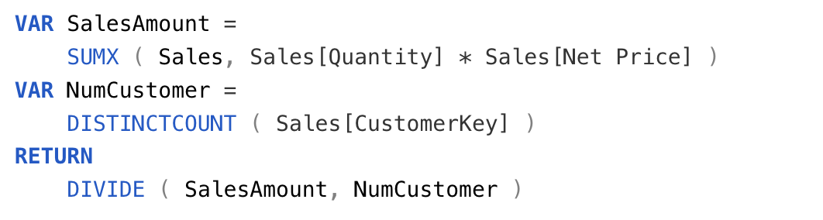
Var-Return pattern
Stores the result of an expression as a named variable,
which can then be passed as an argument to other measure expressions.
5

Slide 12
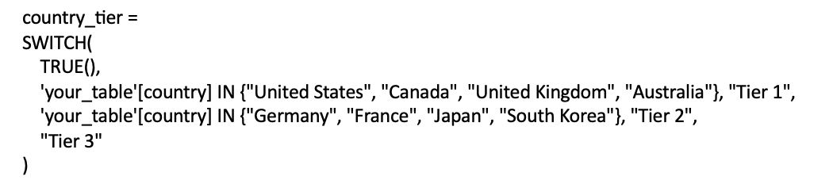
DAX 4 - Switch (Case when)
Tier 1: United States, Canada, United Kingdom, Australia
Tier 2: Germany, France, Japan, South Korea
Tier 3: Các quốc gia còn lại
5

Slide 13

fullstackdatascience.com
References
https://dataedo.com/samples/html/Data_warehouse/doc/AdventureWorksDW_4/home.html
11

Slide 14





Thank you
096 574 90 25
CREATED BY
Nguyen Tien Huy
info@robusto.ai
fullstackdatascience
huynt@fullstackdatascience.com
Data Manager
https://fullstackdatascience.com/
Hanoi, Vietnam

